Slide 1
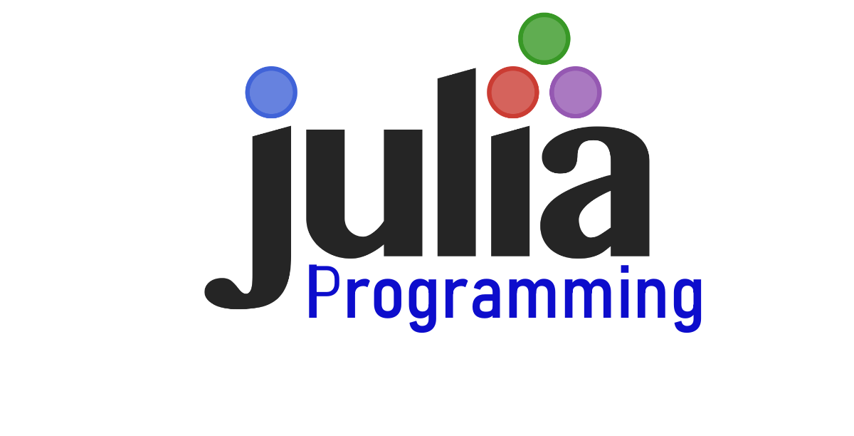
Introduction to

Slide 2
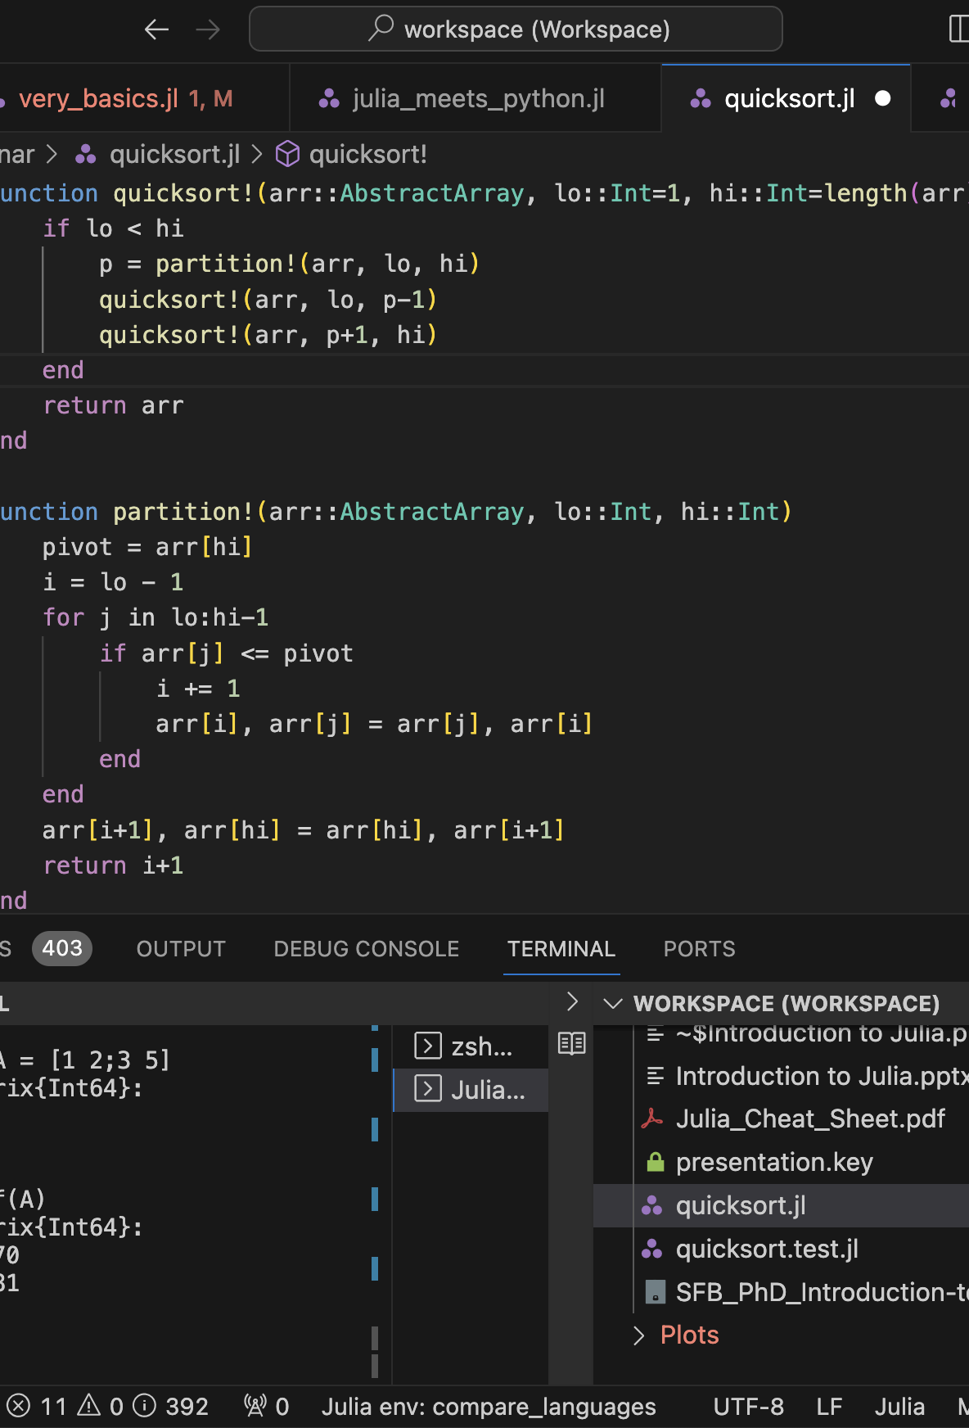
Table of content
Overview of Julia
Advantages for Scientists
Performance and Type System
Julia Ecosystem
Interoperability and Legacy Code
Resources for Learning Julia
Practical Applications and Exercises

Slide 3



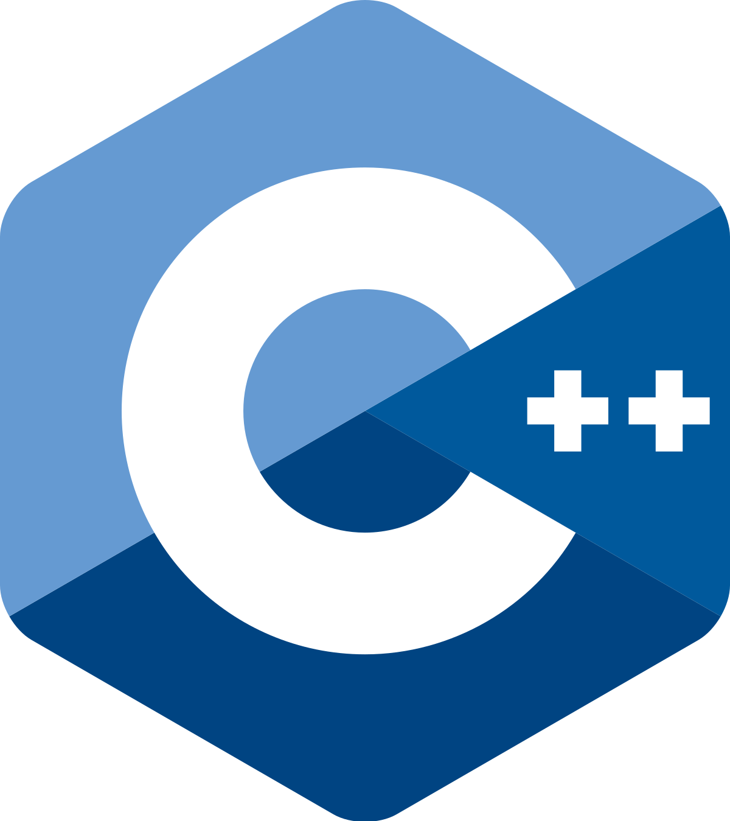

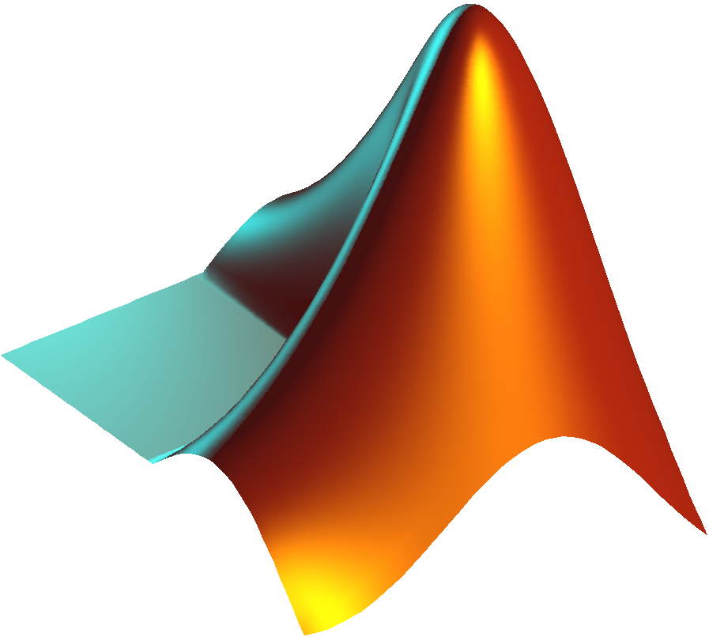
- in a nutshell
High-performance | High-level code
Open source | Designed for technical computing
Active developer community | Rich ecosystem of libraries
Familiar syntax for users of

Slide 4



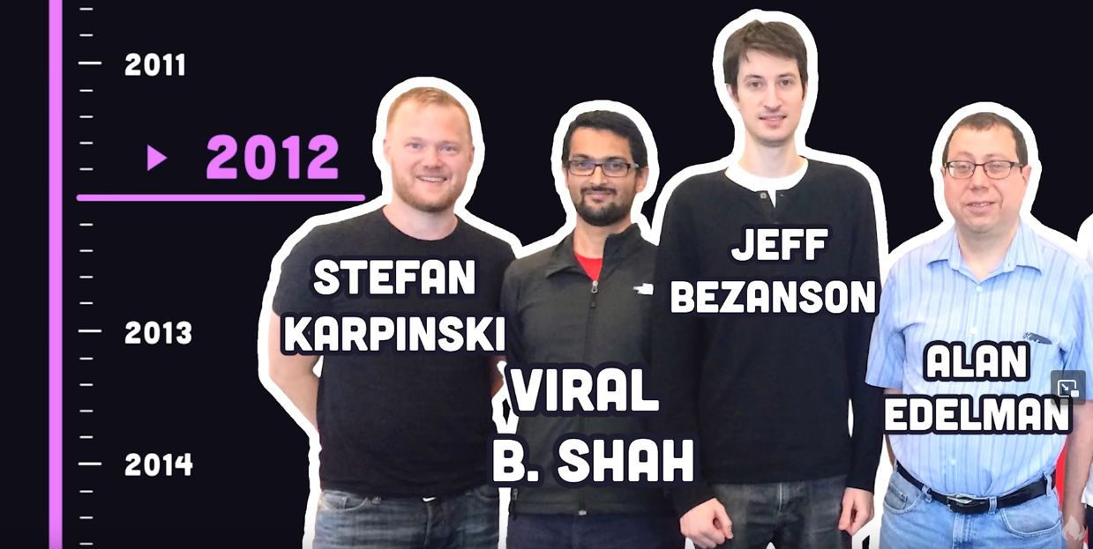

2009 | Work started on Julia by (Python: 1989, C: 1969, Fortran: early 1950s)
2012 | release on github (0.1 alpha)
2015 | First JuliaCon
2018 | v1.0
Post 2018 | Continuous development (currently 1.9 with rc 1.10)
Now:
>10,000 Julia packages
>45 Million downloads

Slide 5
Why should you bother (as a scientist)?
You want a programming language that is:
Easy to write and read
Fast and scalable
interactive
Two-language problem!
Runtime
Code complexity

Slide 6
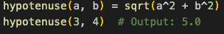
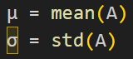
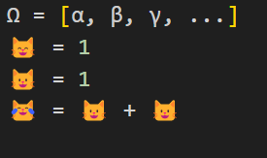
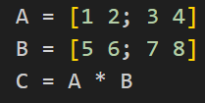
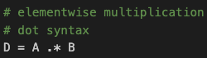
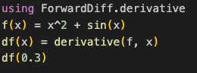
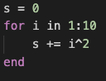
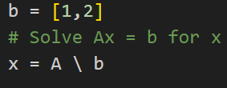
Easy to read and write – just like math

Slide 7
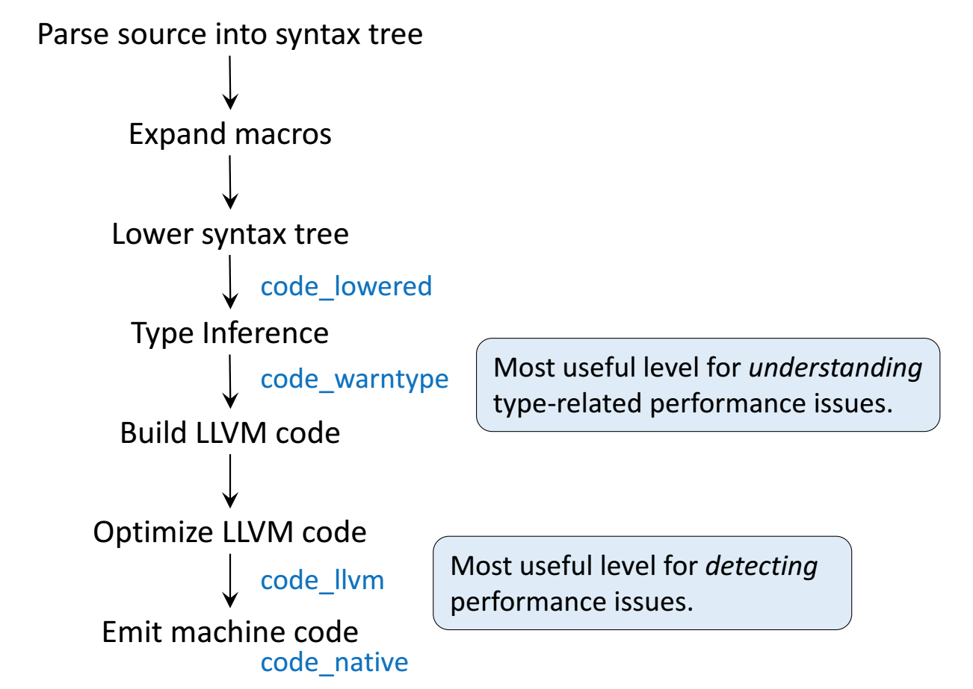
How can Julia be fast ?
Short answer: Julia is a compiled language
Compiler: LLVM
Code interpretation | Just-in-time compilation | Ahead-of-time compilation

Slide 8
How can Julia be fast ?
Short answer: Julia is a compiled language
Compiler: LLVM
julia> function sumup()
x = 0
for i in 1:100
x += i
end
x
end
sumup (generic function with 2 methods)
julia> @code_llvm debuginfo=:none sumup()
; Function Attrs: uwtable
define i64 @julia_sumup_12626() #0 {
top:
ret i64 5050
}
Just returns the answer!
(The for loop was compiled away)

Slide 9
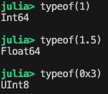
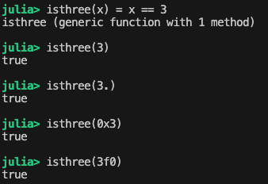
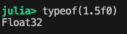
Type system
Julia is a fully typed language

Slide 10
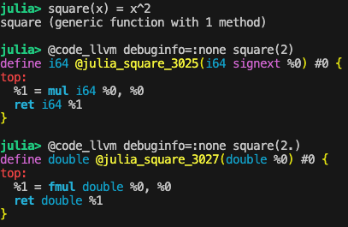
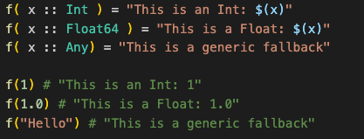
Multiple dispatch
Functions are global
Functions with the same name are specialized on their input types

Slide 11
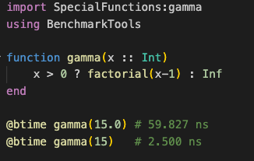
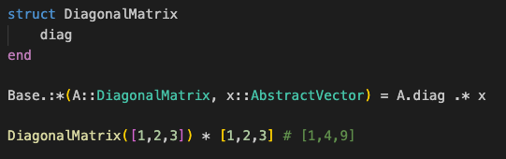
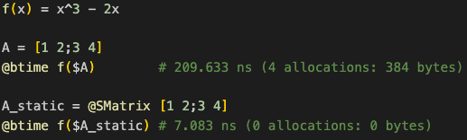
More examples of multiple dispatch
Specializing existing functions
Creating new types
Write generic functions – get specialized code

Slide 12
Summary: How can Julia be fast and readable
Strong type system – allows specialized compiled code
Multiple dispatch – allows writing generic high level code
Tackles two-language problem

Slide 13
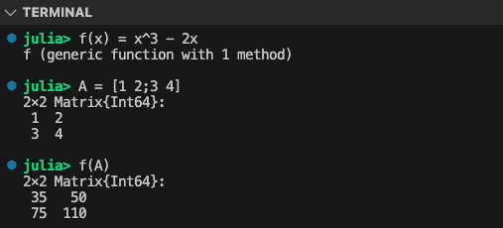
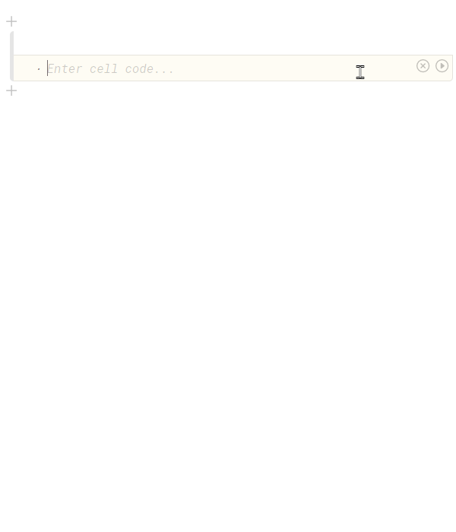
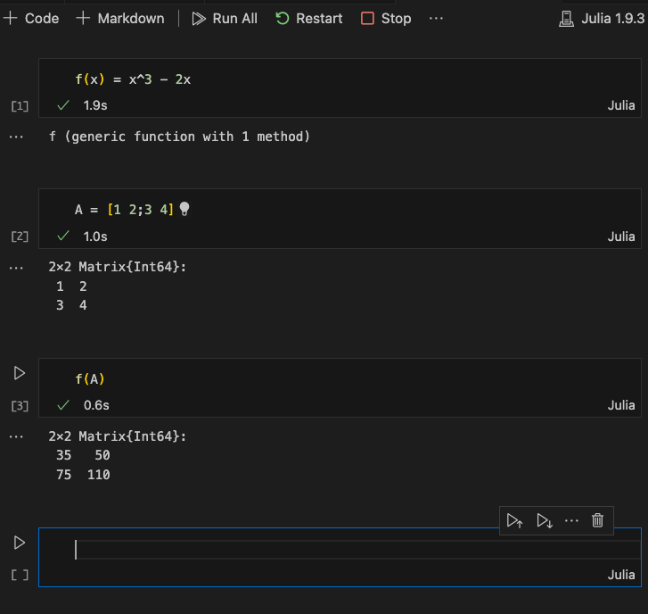
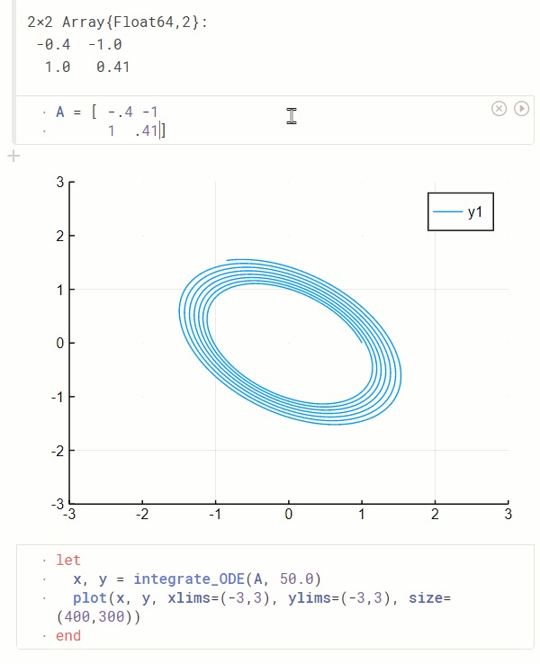
Interactivity
REPL
Jupyter noebooks
Pluto notebooks (reactive!)

Slide 14
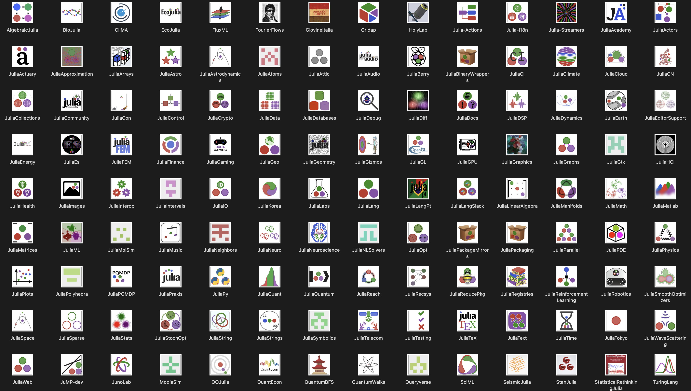
Julia ecosystem
DifferentialEquations.jl
Flux.jl / MLJ.jl / SciML
Optim.jl
JuliaGPU (CUDA.jl, AMD, AppleSilicon)
JuliaDiff
A lot more!!
Julia GitHub Organizations (https://julialang.org/community/organizations/)

Slide 15


But what about my undocumented 20k loc I used over the past years??
Natively can call into C and Fortran code
Packages for calling Python, R, Matlab, etc

Slide 16
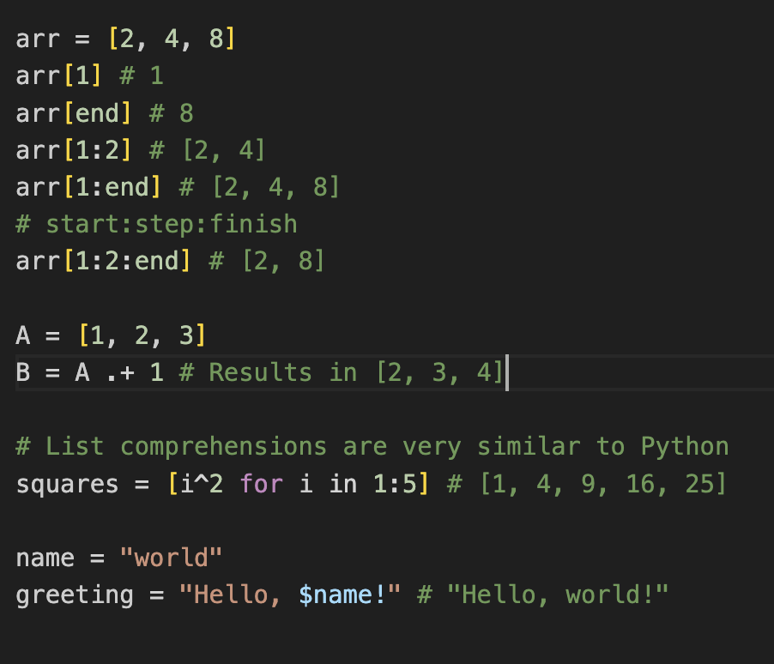
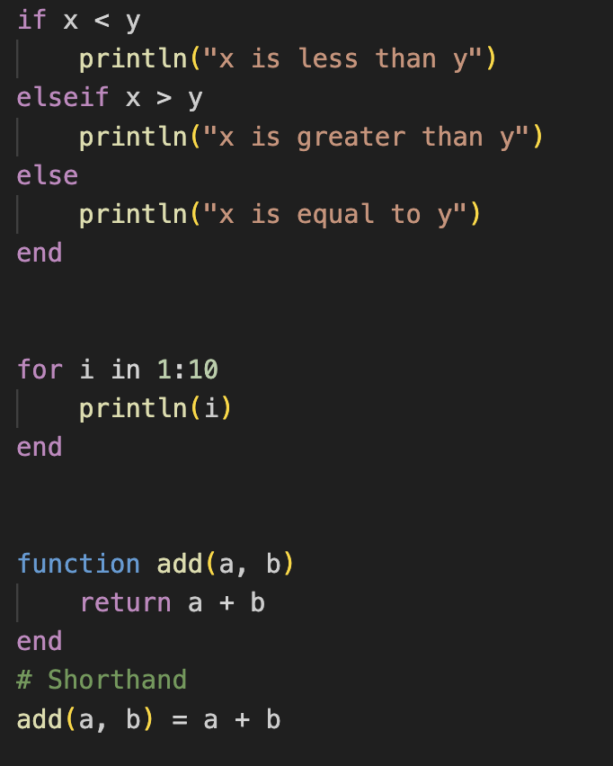
Julia crash course
Julia cheat sheet: https://cheatsheet.juliadocs.org/

Slide 17
From here on…
Official documentation (very well written)
https://modernjuliaworkflows.github.io/
For questions: Julia discourse and slack and stackexchange
ChatGPT, github copilot
Official youtube channel
Some ideas:
Convert some of your C, Fortran, Python, etc code to Julia
Use data visualization with Pluto

Slide 18
Github repository
https://github.com/jamblejoe/SFB_PhD_Introduction-to-Julia
Notebooks with puzzles about
Basics of Julia
Learn about structs and matrix free multiplication and eigenvalue solve
Explore multithreading with Monte-Carlo simulations
Visualize the Mandelbrot set with Sliders and Plots
Call python code from Julia

